Slide 1
DP IB Art Exam
Courtney Welch

Slide 2
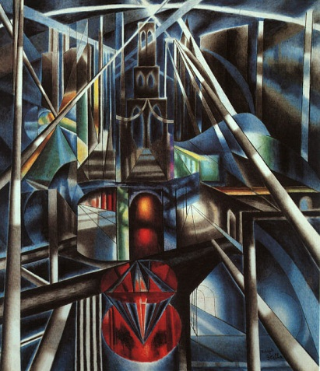
Crystal
Crystal
Acrylic on ….
16in x 20in
November 2011
Joseph Stella
Brooklyn Bridge - 1917

Slide 3
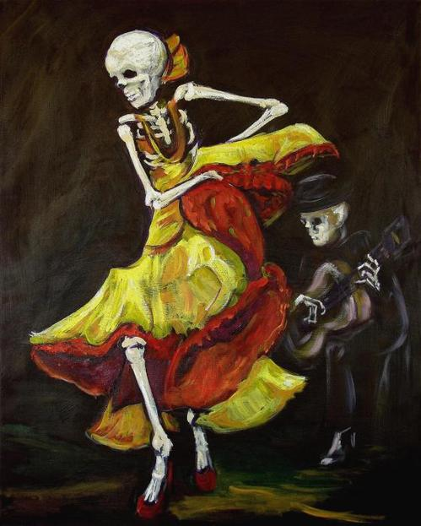
Artist
Artist
Acrylic and Glass on Canvas
2ft x 2ft
December 2011
Sharon Sieben
Flamenco Vi Poster

Slide 4
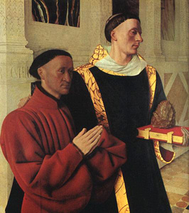
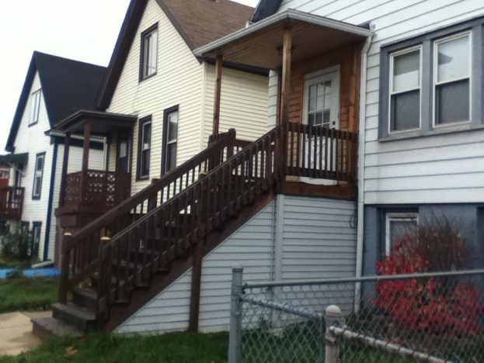
Artist in the City
Jean Fouquet
Étienne Chevalier with Saint Stephen
Artist in the City
Acrylic on Canvas
2ft x 2ft
December 2011
My Old Home
18th and Lincoln

Slide 5
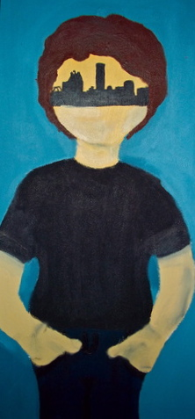
City in the Artist
City in the Artist
Acrylic on Canvas
1ft x 2ft
April 2012
Son of Man
Rene Magritte

Slide 6
Sacred Vessel
Prankster
Clay and Found Object
5in x 11in
April 2012
Kokopelli
South West Native America

Slide 7
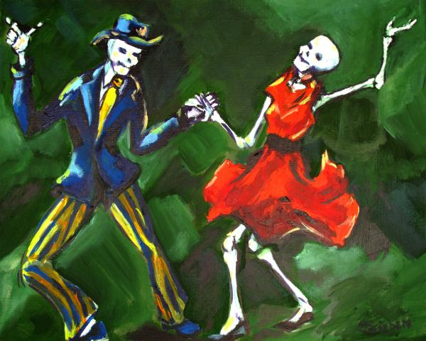
Mono Print
Mono Print
Oil Paints on Paper
8in x 10in
January 2012
Sharon Sieben
The Jive Painting - The Jive Fine Art Print

Slide 8
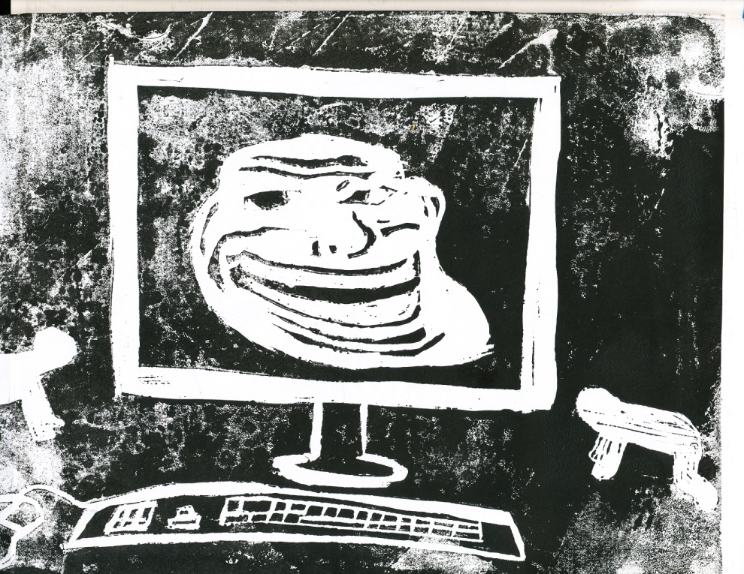
Block Print
Block Print
Ink on Paper
9in x 12in
December 2011
Elizabeth Catlett
My Reward

Slide 9
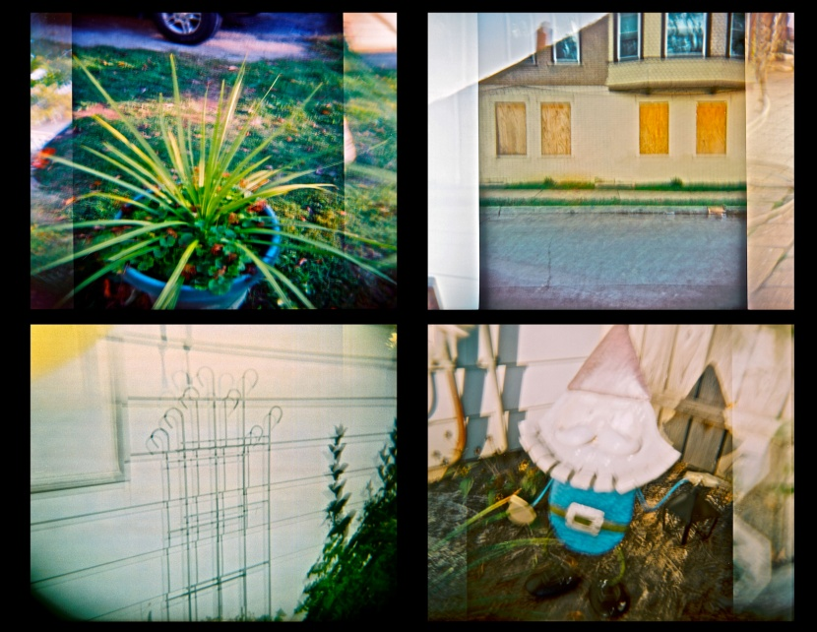
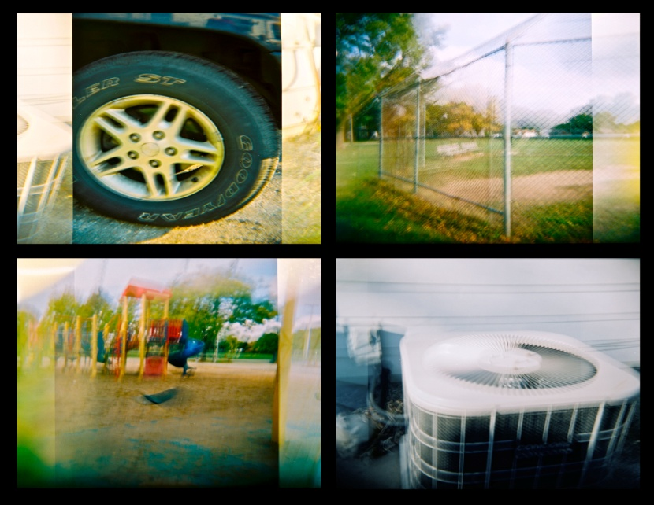
Holga
Holga Prints
Manipulated Holga Shots
10 ¾in x 8in
March 2012

Slide 10
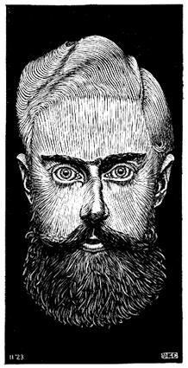
Self-Portrait
M.C. Escher Self-Portrait
Acrylic on Canvas
4ft x 4ft
January 2012
M.C. Escher
Self- Portrait 1922 Woodcut

Slide 11
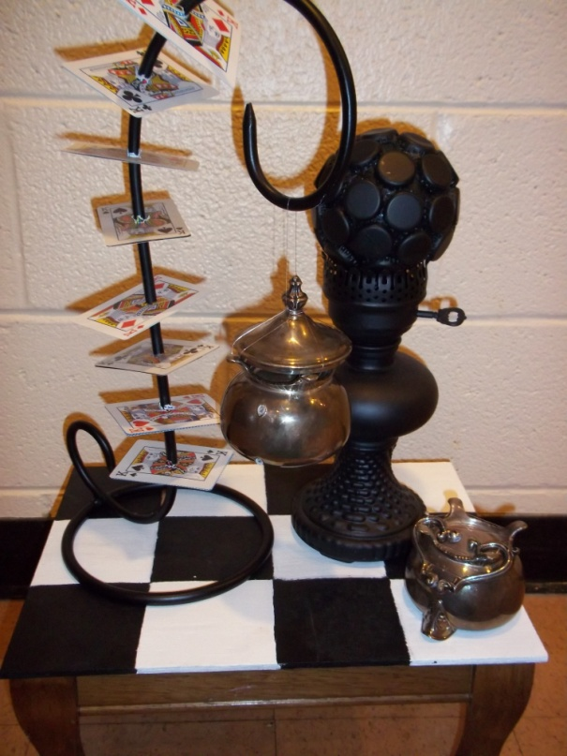
Found Object
Chess
Found Objects
Base- 11in x 14 in
Height- 25 ½ in
February 2012
Man Ray
Chess Set

Slide 12
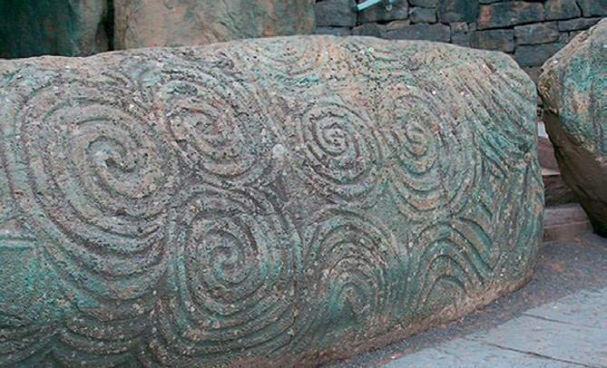
Painting Based on Photography
Thumbprint
3ft x 3ft
Acrylic on Canvas
April 2012
Stones of Newgrange
Ancient Chinese Sculpture

